Slide 1
Challenges in estimating environmental exposures for human health
Jenna R. Krall
Assistant Professor
Department of Global and Community Health
George Mason University
Notes:
Thank you so much for being here today, and thanks Amanda for the invitation. So as a statistician, I’m coming at environmental health from a maybe less conventional field. In my work, I try to understand how air pollution impacts health and whether we need better analytical and statistical tools to achieve that goal.

Slide 2
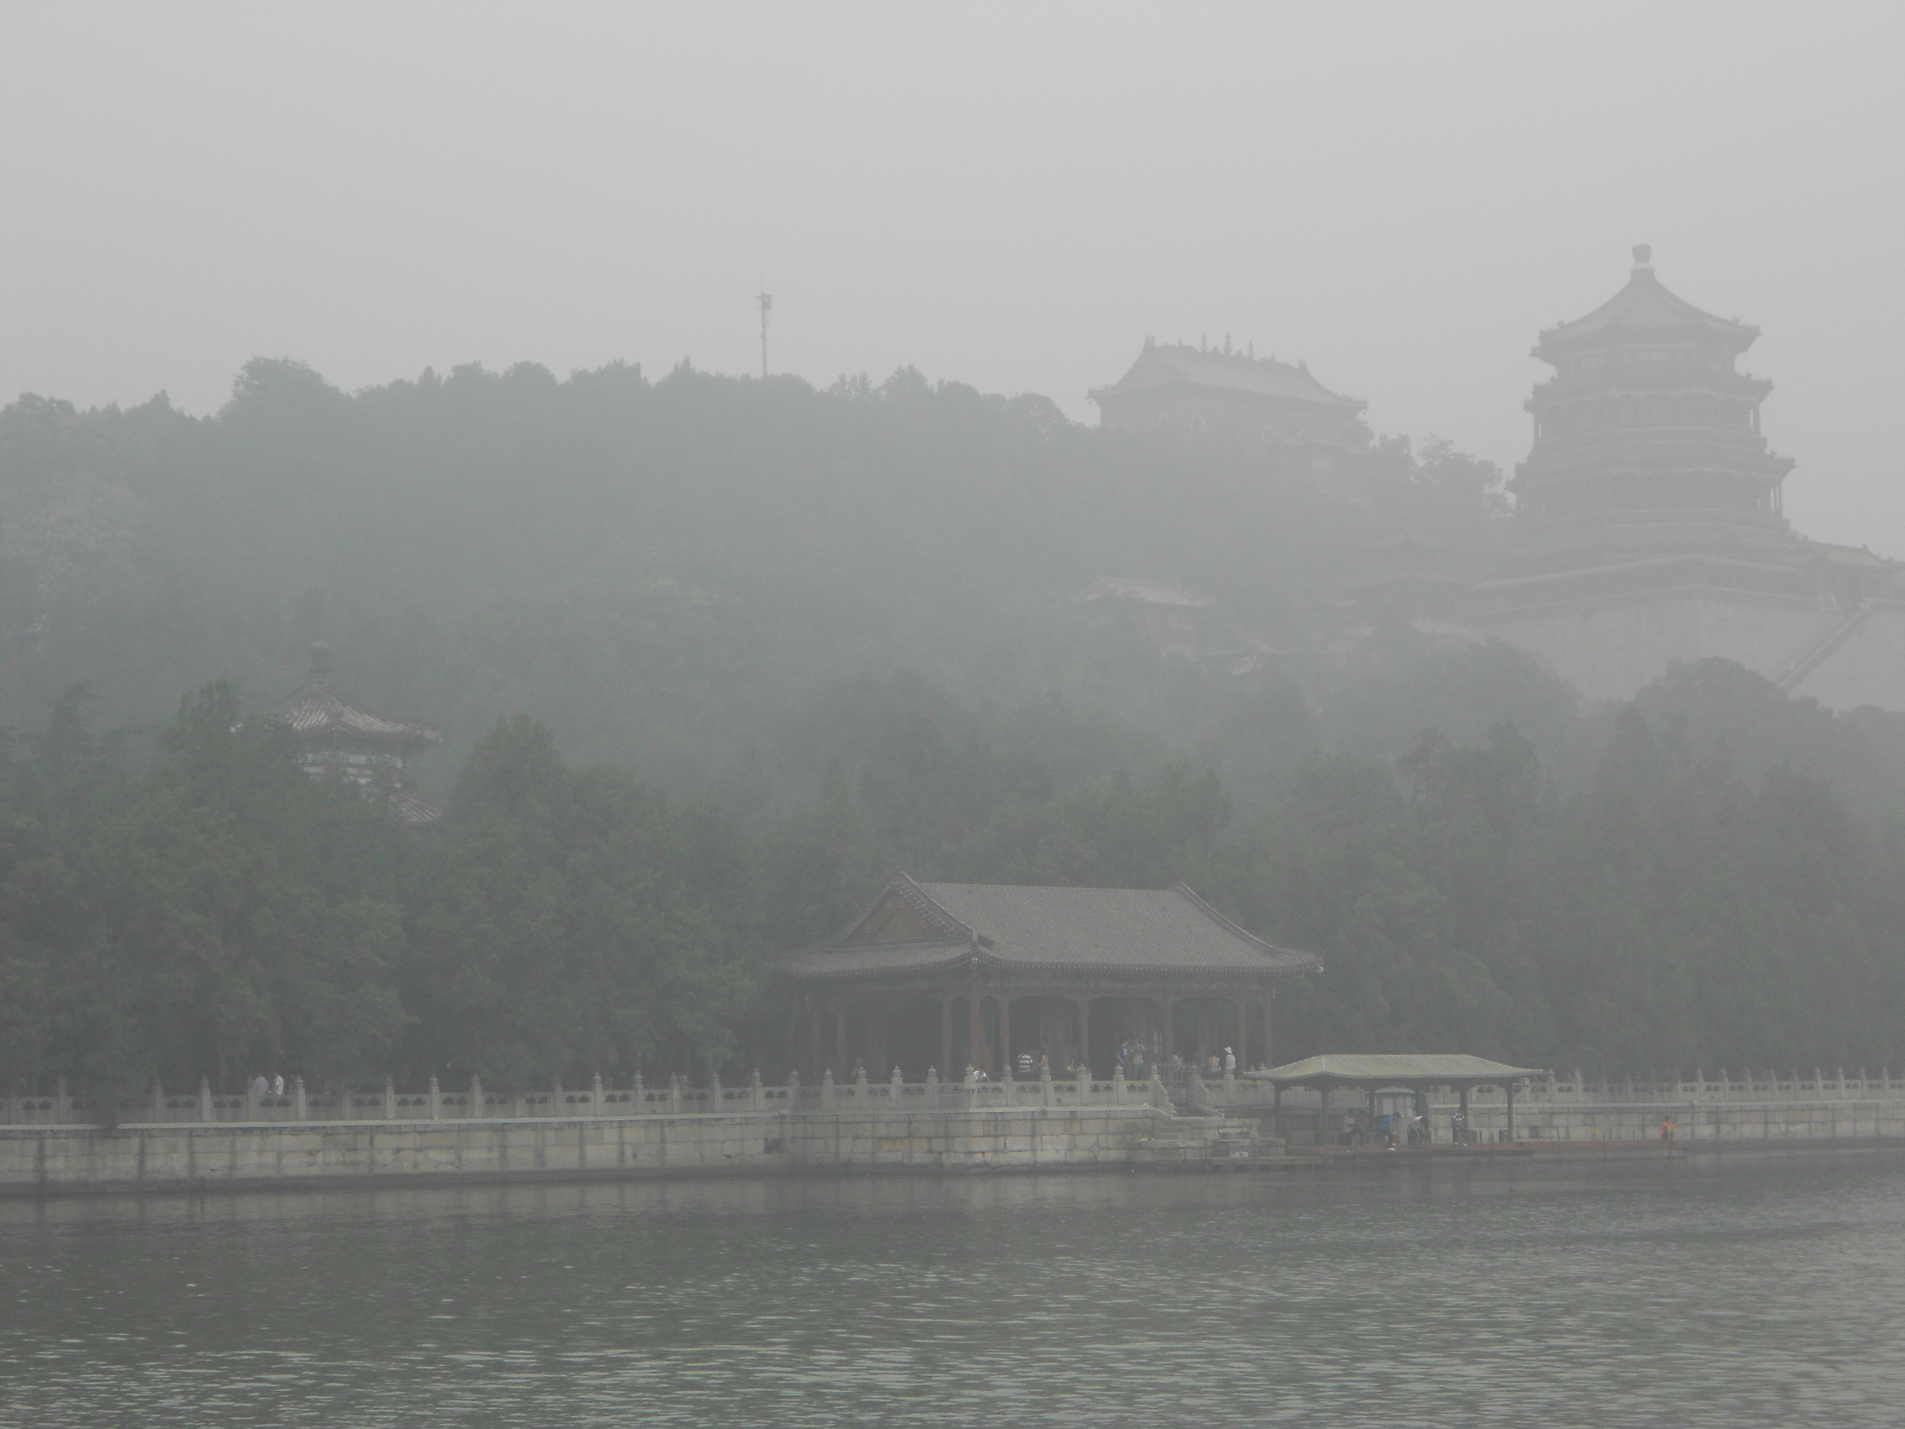
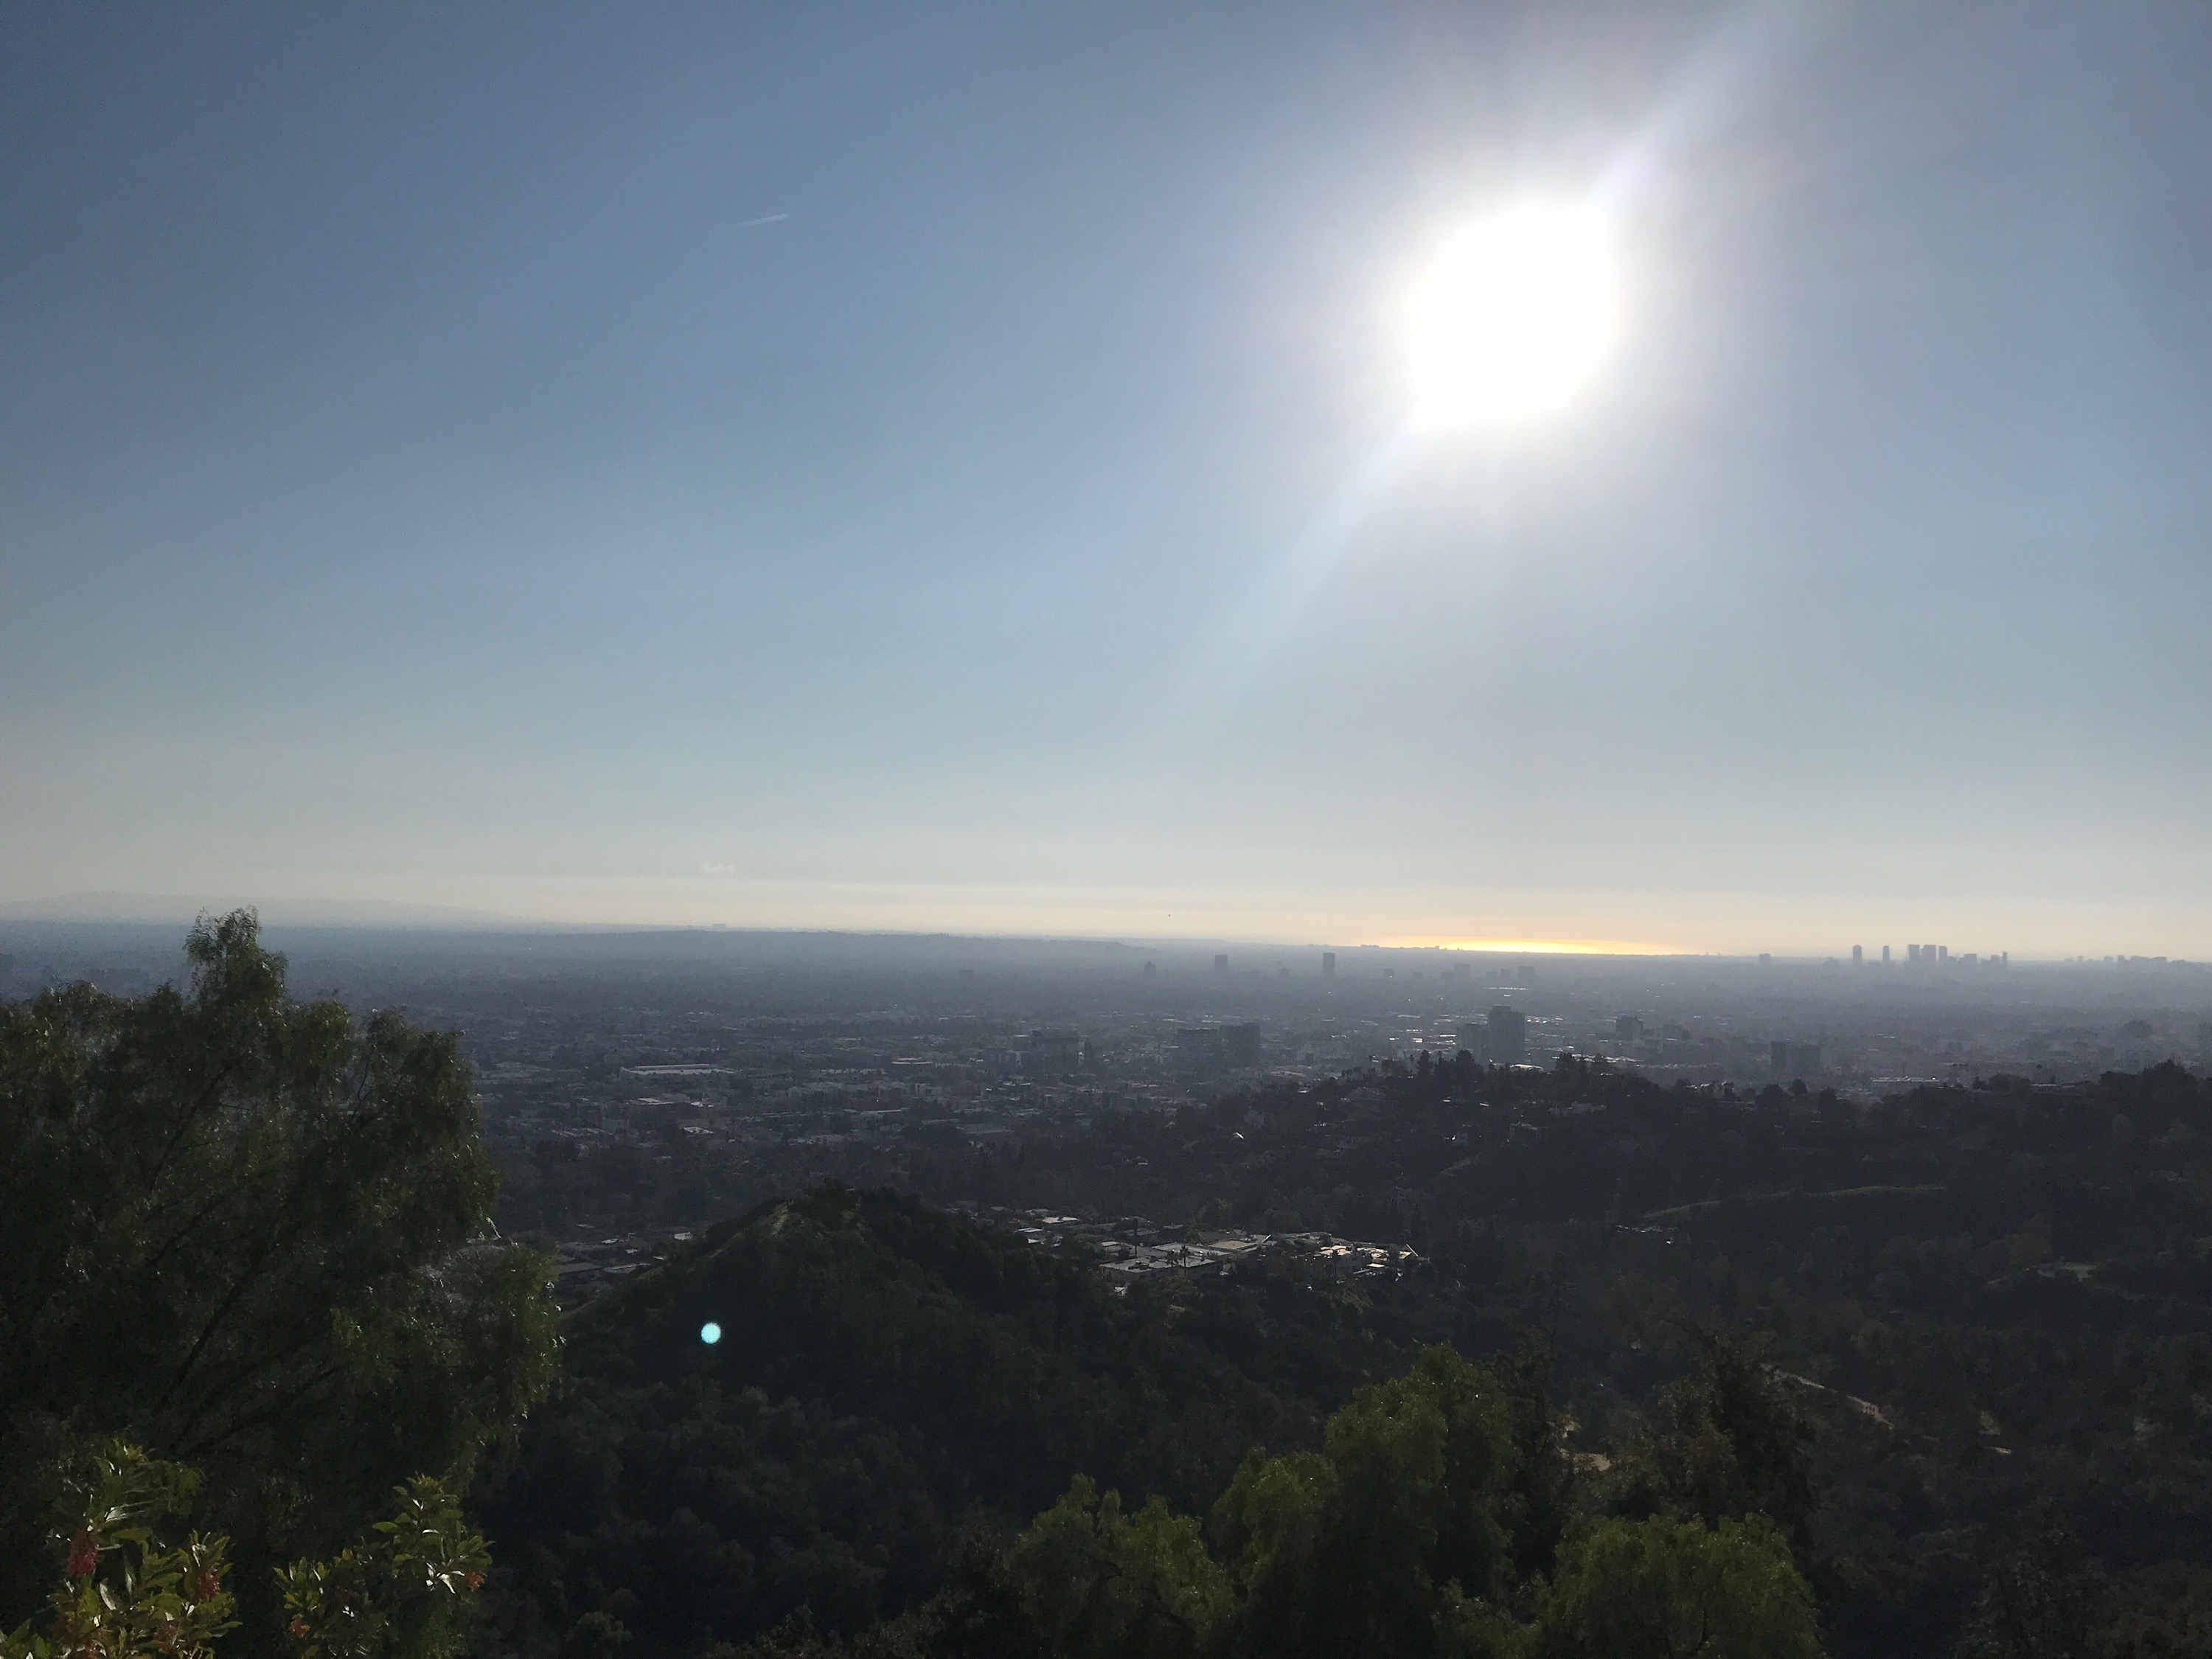
Beijing, China (2011)
Canberra, Australia (2020)
Image: nytimes.com, Narendra Shrestha/EPA, via Shutterstock
Los Angeles, CA (2020)
Northern VA?
Notes:
Air pollution is a worldwide challenge, and, in the US, outdoor or ambient air pollution is associated with over 200,000 deaths each year. Generally speaking, air pollution is a mixture of both gaseous pollutants, such as ozone or nitrogen dioxide, and particle pollutants.
In many places, air pollution is a visible problem. We see the pollution and may change our behaviors, such as staying indoors, wearing a mask outside, and avoiding exercise outdoors. So how does the DC area stack up?
PM >350 micrograms/m3.

Slide 3
Beijing, China (2011)
Canberra, Australia (2020)
Image: nytimes.com, Narendra Shrestha/EPA, via Shutterstock
Los Angeles, CA (2020)
Northern VA?
Image: Washington Post, National Park Service webcam
Notes:
Here is a photo and headline from about a year ago, when a large inversion trapped pollution in the area for several days, which built up to a visible haze.

Slide 4
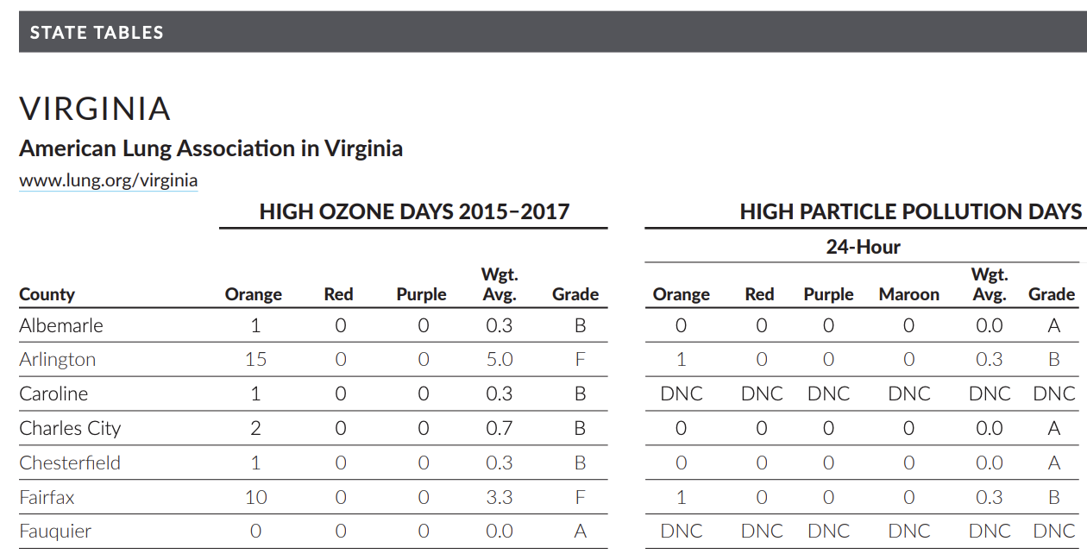
American Lung Association State of the Air 2019
Particulate matter (PM)
Notes:
In 2019, the American Lung Association gave grades of F to Arlington and Fairfax counties for their high ozone pollution days, and grades of B for their particle pollution

Slide 5
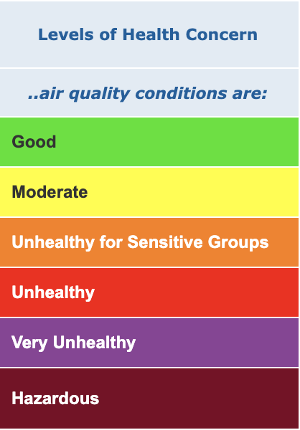
American Lung Association State of the Air 2019
Notes:
For reference, an orange air pollution day indicates that levels of that pollution are harmful for sensitive groups, which includes both children and older adults.

Slide 6
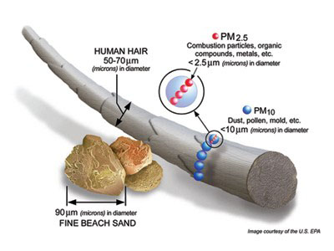
Particulate matter (PM)
Image: Bell et al. 2007 EHP
The US EPA has classified the evidence for associations between short-term exposure to PM2.5 and
• Mortality and cardiovascular outcomes as causal
• Respiratory outcomes as likely to be causal
Notes:
However, unlike ozone, particulate matter is a heterogeneous mixture of particles with differing chemical composition. This talk will mostly be focused on PM2.5, so the small particles that are frequently generated by combustion processes like traffic, wildfires, or power plants. In the eastern US, we have seen that PM2.5 is made up of carbon chemicals, like organic and elemental carbon, as well as sulfate, nitrate, and ammonium. This heterogeneity is important because all PM2.5 pollution is not created equal, and research has shown that the chemical composition of PM2.5 can change its toxicity and impact on human health.

Slide 7
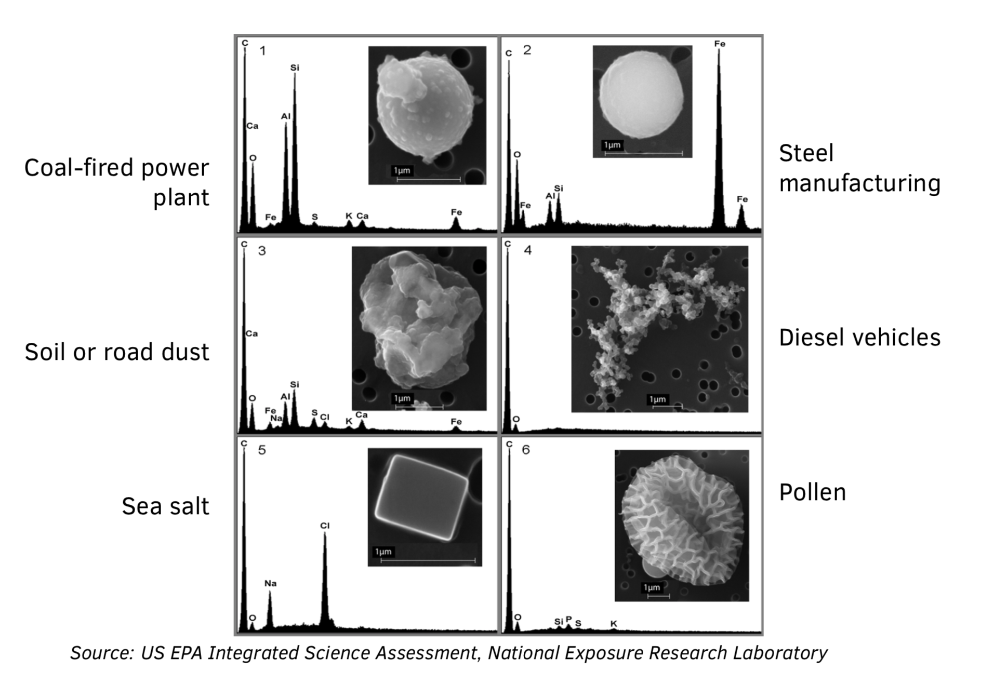
Particulate matter
Notes:
One factor in the heterogeneity of these particles is the difference in chemical composition by source. So on the horizontal axis here, the spikes indicate different chemicals. Particles emitted by a coal-fired power plant contain carbon, but also aluminum and silicon. Whereas, steel manufacturing, not surprisingly, contain relatively more iron. So thinking back to the American Lung Association report, and also to how PM is regulated and how poor air quality days are identified. These reports and these regulations are based on total PM pollution, and does not differentiate by composition.

Slide 8
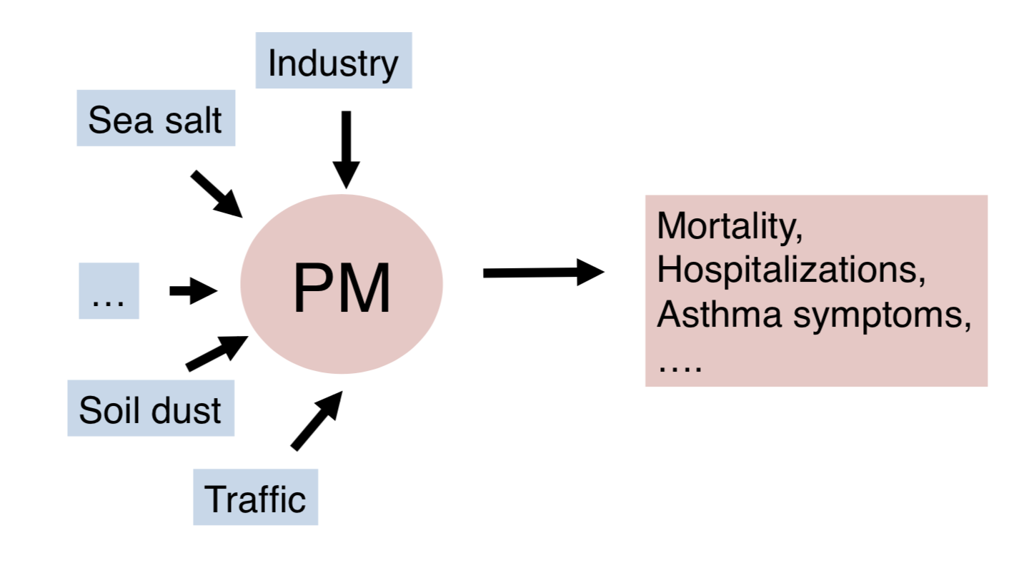
Particulate matter and health

Slide 9
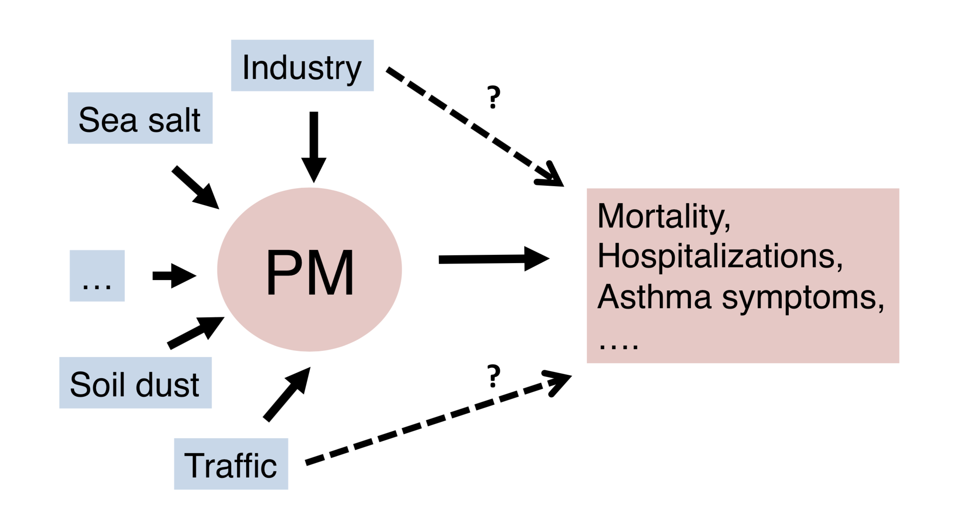
Challenge:

Slide 10
Particulate matter
Image: nps.gov

Slide 11
Challenges in estimating environmental exposures for human health:
Exposure to traffic-related air pollution
Jenna R. Krall
Assistant Professor
Department of Global and Community Health
George Mason University
Notes:
Thank you so much for being here today, and thanks Amanda for the invitation. So as a statistician, I’m coming at environmental health from a maybe less conventional field. In my work, I try to understand how air pollution impacts health and whether we need better analytical and statistical tools to achieve that goal.

Slide 12
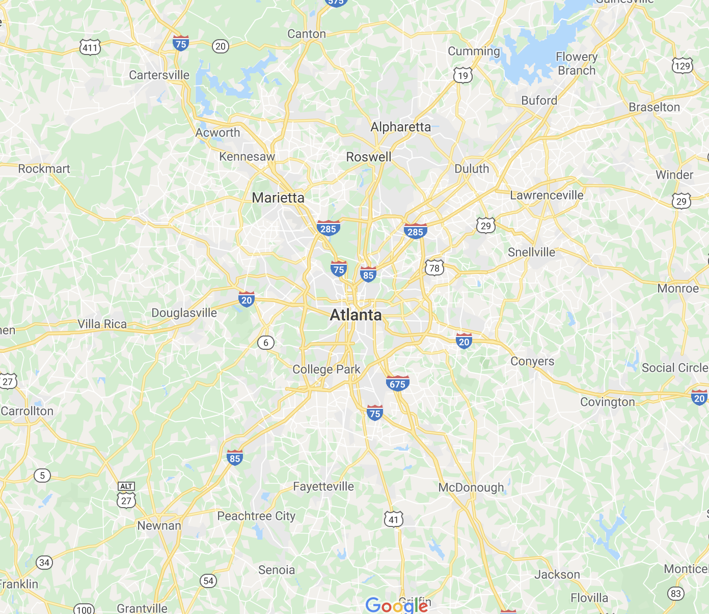
Particulate matter and roadways
Zhai et al. 2016 Atmos Env

Slide 13
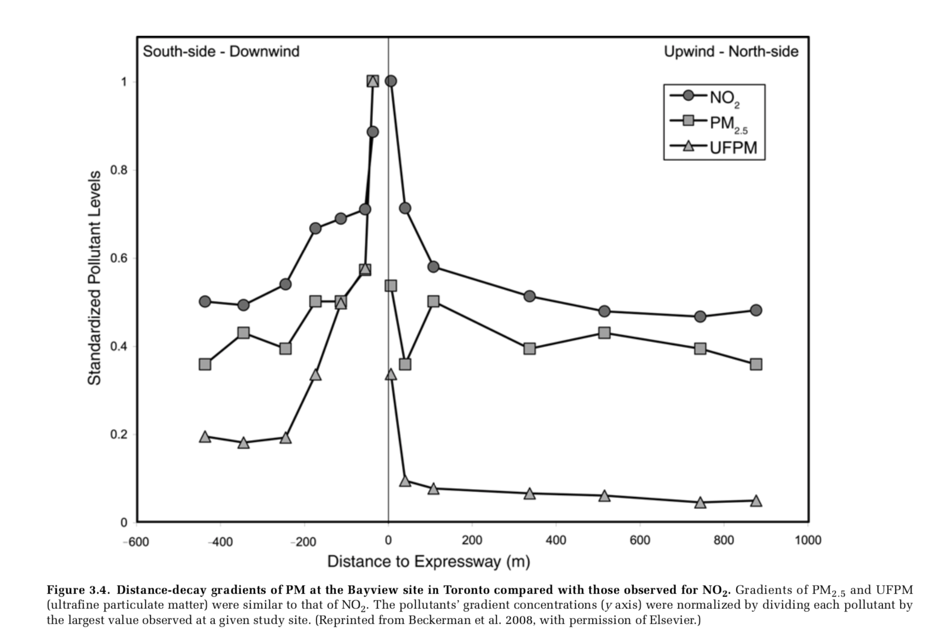
Particulate matter and roadways
HEI Panel on the Health Effects of Traffic-Related Air Pollution, 2010

Slide 14
Beijing, China (2011)
Canberra, Australia (2020)
Image: nytimes.com, Narendra Shrestha/EPA, via Shutterstock
Los Angeles, CA (2020)
Northern VA?
Image: Pouya Dianat/The Washington Post
Notes:
We also know that our region is one of the worst in the nation for traffic. The 2019 Urban Mobility Report listed DC as the third most congested area, following LA and San Francisco. So, one of my interests is thinking about what this traffic means in DC with respect to air pollution

Slide 15
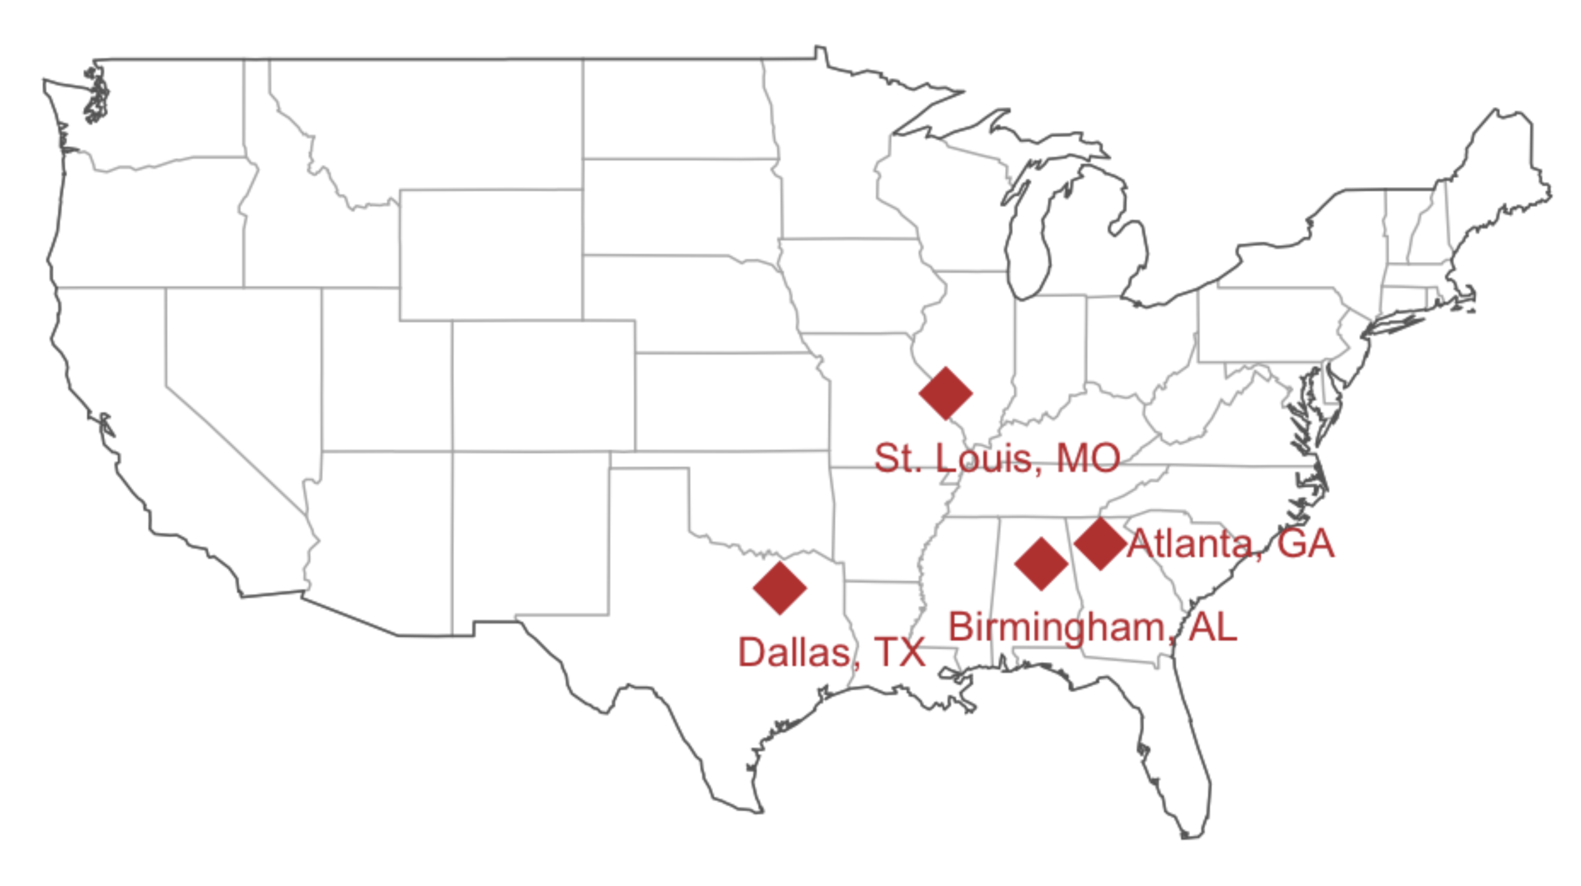
Sources of pollution and respiratory ED visits
Image: Krall et al. 2017, Sarnat et al. 2013

Slide 16
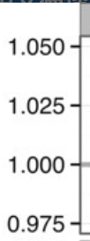
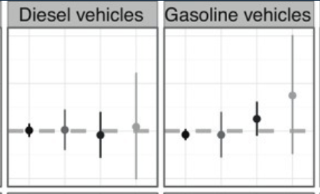
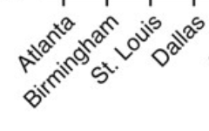
Sources of pollution and respiratory ED visits
PM2.5 was associated with increased respiratory disease ED visits
PM2.5 from diesel and gasoline vehicles was not associated with increased ED visits
Issues: Small sample sizes, difficulty estimating traffic-related PM2.5
Relative risk
Image: Krall et al. 2017

Slide 17
Sources of pollution and cardiovascular hospitalizations in the northeastern US
Monitor locations where traffic pollution exposure was estimated well
Image: Krall et al. 2017, Stat Med

Slide 18
Sources of pollution and cardiovascular hospitalizations in the northeastern US
Traffic-related PM was associated with increased cardiovascular hospitalizations in the northeastern US
Issues: Traffic pollution exposure could not be estimated in many cities
Image: Krall et al. 2017

Slide 19
Traffic-related air pollution and subclinical health
Krall et al. 2018

Slide 20
Traffic-related air pollution and subclinical health
Brake wear
Tire wear
Road dust?
Krall et al. 2018

Slide 21
Traffic-related air pollution and subclinical health
?
Krall et al. 2018

Slide 22
The GEST-DC study: Exposure to traffic-related air pollution in the DC metro area

Slide 23
The GEST-DC study
Exposure to air pollution during pregnancy may increase risk of pre-term birth, low birthweight, gestational diabetes, and preeclampsia.¹⁻³
Women in the DC metro area, compared with other cities,
are employed at higher rates (64.1% vs. 55% in LA and NYC)⁴
have long, congested auto commutes (>80 delay hours annually)⁵⁻⁶
¹Bell et al. (2010) Epidemiology; ²Sapkota et al. (2012) Air Quality, Atmosphere & Health; ³Malmqvist et al. (2013) Environmental Health Perspectives; ⁴Bureau of Labor Statistics; ⁵Texas A&M Transportation Institute (2015) Urban Mobility Scorecard; ⁶American Community Survey.

Slide 24
The GEST-DC study
46 participants were recruited during 2018-2019 through flyers, online message boards, and word-of-mouth in northern Virginia. Eligibility criteria included:
Women
18-55 years old
Living in northern Virginia
Commute at least 15 minutes to work at least three days a week by personal vehicle.
Each participant completed a 48-hour data collection period

Slide 25
The GEST-DC study
Vehicle monitors
Trip time
Speed
Other metrics
Personal pollution monitors
PM2.5
RTI MicroPEMTM

Slide 26
The GEST-DC study

Slide 27
The GEST-DC study
Preliminary findings:
Vehicle monitors can be used to determine trip times
Exposure to PM2.5 is greater during vehicle trips compared to time outside the vehicle, and this difference is greater during rush hour trips
Future work:
Determine associations with speed, traffic, and other trip-related factors
Potential implications:
Effect of work from home policies on PM2.5 exposure
Change commute to reduce personal PM2.5 exposure

Slide 28
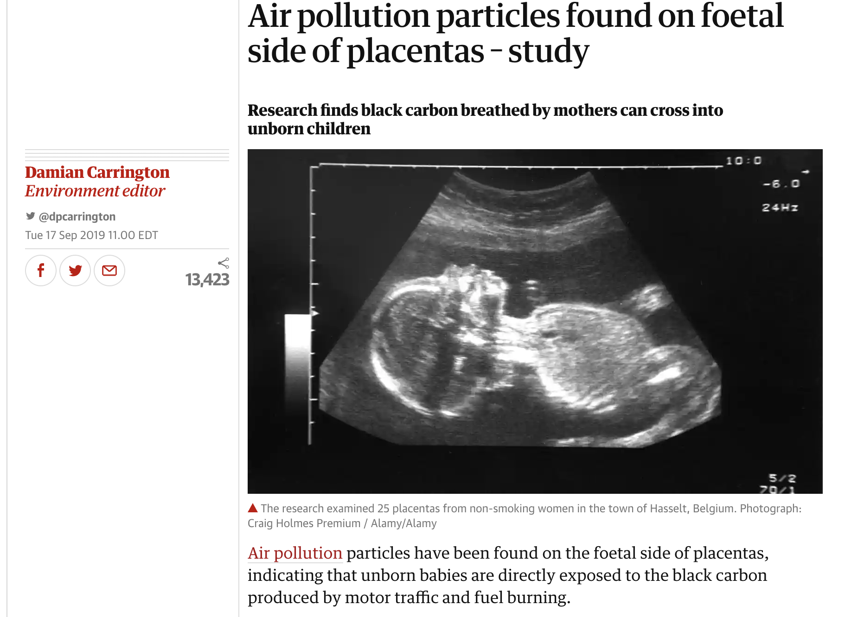
Traffic pollution and women’s health
The Guardian

Slide 29
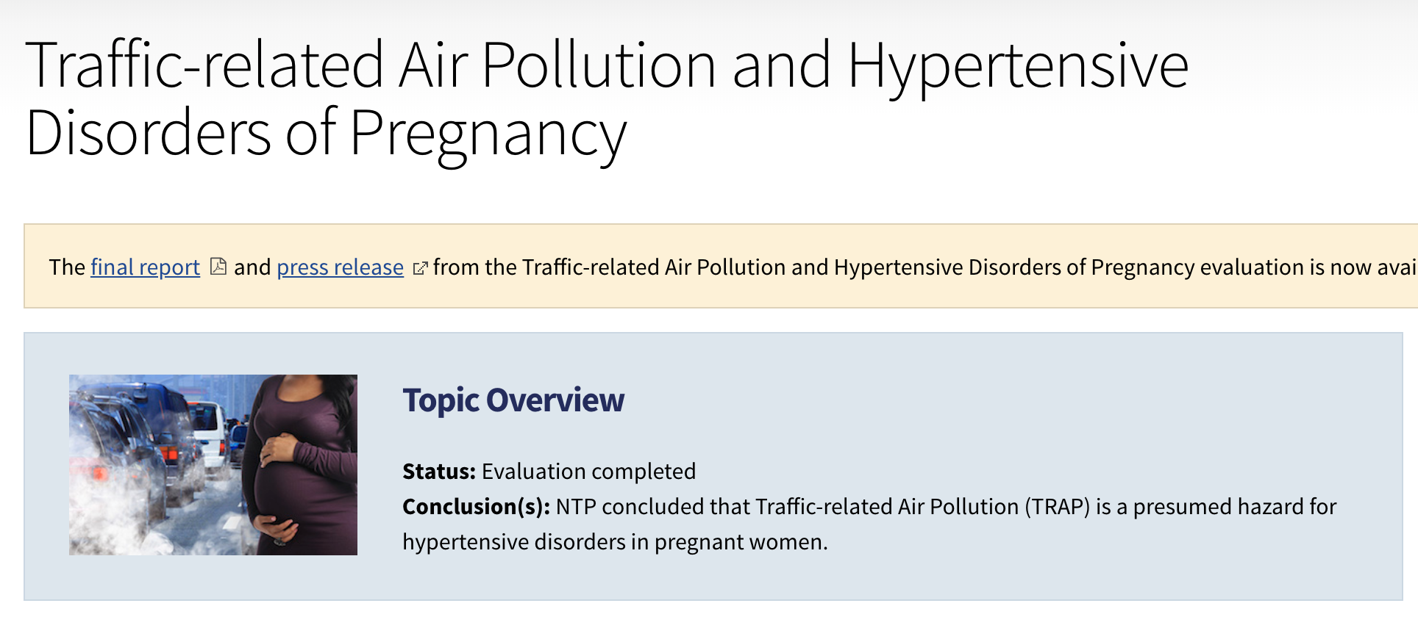
Traffic pollution and women’s health
December 2019

Slide 30
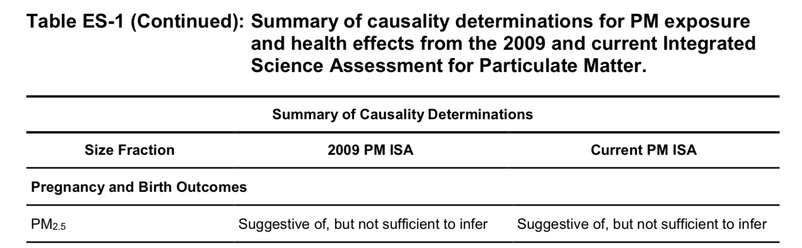
Particulate matter and health
2019 ISA for PM

Slide 31
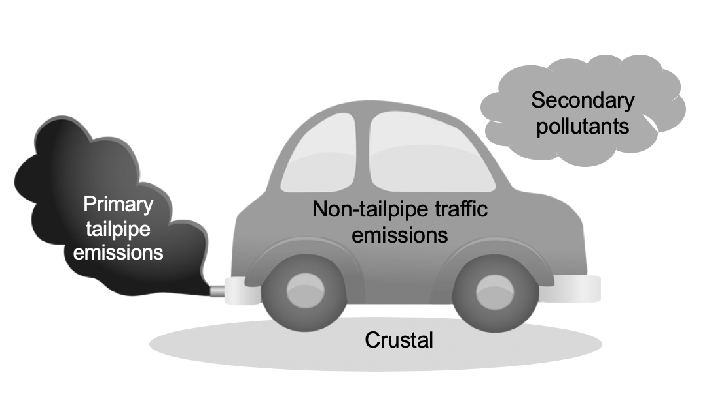
The future of traffic pollution
Electric and hybrid vehicles
Virginia General Assembly: Climate change and reducing power plant emissions
Regional Greenhouse Gas Initiative
Green New Deal

Slide 32
Thanks!
Jenna Krall
jkrall@gmu.edu
Acknowledgements:
George Mason:
Anna Pollack
Yi-Ching Lee
Vivian Motti
RTI
Jonathan Thornburg
Michelle McCombs
Collaborators:
Johns Hopkins
Roger Peng
Emory University
Stefanie Sarnat
Jeremy Sarnat
Paige Tolbert
Lance Waller
Georgia Tech
Ted Russell
This work was supported by a multidisciplinary seed grant from George Mason University and The Thomas F. and Kate Miller Jeffress Memorial Trust, Bank of America, Trustee.

